Slide 1
UK responses to domestic abuse, and how CV-19 is creating new problems and new opportunities
Briony Williamson,
Head of Learning & Development

Slide 2
About SafeLives
We are SafeLives, the UK-wide charity dedicated to ending domestic abuse, for everyone and for good.
We are independent, practical and evidence-led, with survivor voice at the heart of our thinking.
We work with organisations across the UK to transform the response to domestic abuse.
We want what you want for your best friend:
Action before someone is harmed or harms others
Harmful behaviour identified and stopped
Increased safety for everyone at risk
The ability for people to live the life they want after harm has happened

Slide 3
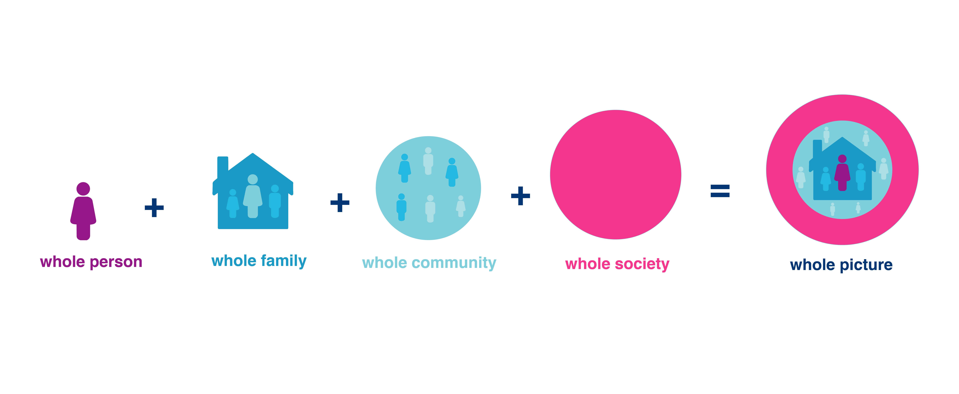
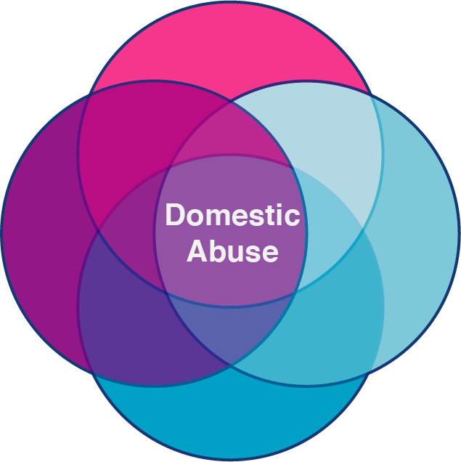
The Whole Picture: Our strategy to end domestic abuse, for good
The whole person: domestic abuse is never all of someone’s experiences or situation.
Notes:
Link to our strategy - The Whole Picture: http://www.safelives.org.uk/sites/default/files/resources/The%20Whole%20Picture%20-%20SafeLives%27%20Strategy.pdf

Slide 4
Domestic abuse:
Current picture in the UK
Notes:
England:
After an evaluation of a SafeLives innovation, the Home Office funded the rollout of Idvas (Independent Domestic Violence Advisors) and Maracs (Multi-Agency Risk Assessment Conferences)
Coverage of Idvas vary widely by region – there are around 1100 Idvas working in the UK, but often part time. We need another 300 to meet the needs of victims at the highest risk of serious harm or murder
2015 Serious Crime Act introduced coercive and controlling behaviour as a crime – but didn’t roll out training for police officers.
SafeLives innovated a programme of cultural change training – DA Matters. Half of English and Welsh forces trained, plus all of Police Scotland.
Domestic Abuse Bill is making its way through Parliament currently – introduces a statutory definition of domestic abuse (including economic abuse for the first time), establishes a Domestic Abuse Commissioner and introduces a new Protective Order
Wales:
VAWDASV – Violence Against Women, Domestic Abuse and Sexual Violence Act (2015).
Focusses on prevention of abuse
Protection of victims
Support for all involved
“Ask and Act” – Welsh Government have introduced an organisational duty to encourage relevant public sector professionals to “Ask” potential victims in certain circumstances (targeted enquiry); and
to “Act” so that harm as a result of the violence and abuse is reduced
Scotland:
Domestic Abuse legislation passed introduced in Scotland in 2019.
Recognised variety of abuse such as emotional abuse and coercive and controlling behaviour for the first time.
1,313 incidents were recorded by Police Scotland between April and December.
Police Scotland emphasised that investment in their training has made the legislation such a success.
SafeLives supported the implementation of the Domestic Abuse (Scotland) Act by delivering Domestic Abuse (DA) Matters training to all police officers.
Northern Ireland:
Collapse of Stormont has meant that much of NI’s legislation is outdated.
Stalking and Harassment Law (1997)
Northern Ireland is introducing Coercive Control Legislation at the moment. They are the only nation to not have CCB as a criminal defence.
Currently no Idva role in Northern Ireland but a new advocate role is due to be introduced in 2021

Slide 5
Domestic abuse:
Impact of Covid-19
Notes:
Counting Dead Women project have calculated that there has been a doubling of domestic homicides during this period
National Domestic Abuse Helpline has seen an increase in calls of 60% while Police have seen an increase in DA incidents of 8% compared with last year
Local services haven’t seen a huge increase which suggests victims might be waiting until lockdown is over to reach out for practical support – surge in victims reaching out is predicted
UK Govt slow to react but has now launched a £28m fund, introducing a national code word and next steps are to influence the future sustainability of the sector.

Slide 6
Reaching In
#ReachIn is a SafeLives social media campaign that launched in April and will run for as long as it’s needed during lockdown and the period afterwards
SafeLives have been sharing stories and messages from Pioneers, talking about times when someone ‘reached in’ and the difference it made
Plus tips and guidance for people who are community volunteers or are concerned about someone they know
© SafeLives 2020

Slide 7
Impact of Covid-19:
Local innovation
Notes:
New web chat facilities
All services moved online, including child therapy in some cases, and one-to-one perpetrator support
Work with local supermarkets to put their local helplines on receipts

Slide 8
Domestic abuse:
How can local funders help?
Notes:
The initial publication of findings told us that almost one in six (16%) services were experiencing financial difficulties, with over half (53%) of those saying that this was due to funding opportunities having dried up and almost one in six (16%) due to local commissioning changing due to Covid-19. The numbers for the second iteration of the survey were comparable to this. We also found that priorities for funding were changing. Services commented how funding pots that they would usually apply for, for example to cover core funding, have become Covid-19 funds and they are no longer eligible to apply for them.

Slide 9
The Whole Picture: Our strategy to end domestic abuse, for good
The whole person: domestic abuse is never all of someone’s experiences or situation.
Notes:
Ensure that funders looking to support DA Provision are ensuring it takes a whole family approach
Less than 1% of perpetrators of abuse get specialist support

Slide 10
Domestic abuse:
Future national campaigns
Notes:
Misogyny as a hate crime
“Rough sex” defence outlawed as murder (this has now been included in DA Bill)
National perpetrator strategy
End to No Recourse for Public Funds
Statutory duty to commission specialist domestic abuser services for the whole family – adult and child victims, and perpetrators

Slide 11
SafeLives is listening
Get in touch:
Briony.williamson@safelives.org.uk
http://www.safelives.org.uk/
Twitter @safelives_
Facebook.com/safelives.uk
Notes:
Link to SpotLights homepage: http://safelives.org.uk/knowledge-hub/spotlights

